Slide 1
Plot Price Prediction
Dataset Visualization & Analysis
Hasnain Naeem • December 13, 2019

Slide 2
Outline
Looking into Attribute Values
Checking Correlation between Price and other Attributes
Visualizing Locations of Plots
Performance Comparison of various ML Models
Conclusion

Slide 3
Looking into Attribute Values

Slide 4
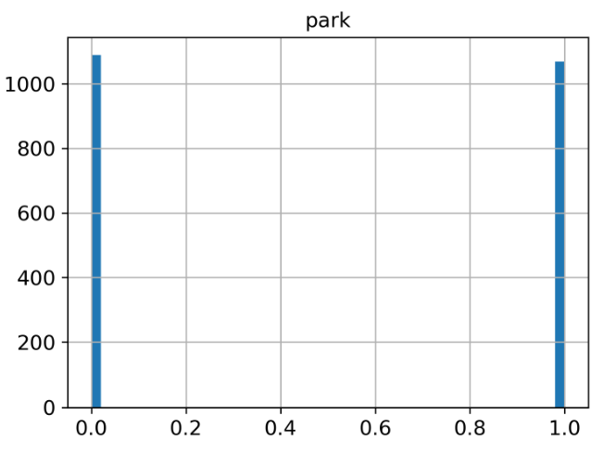
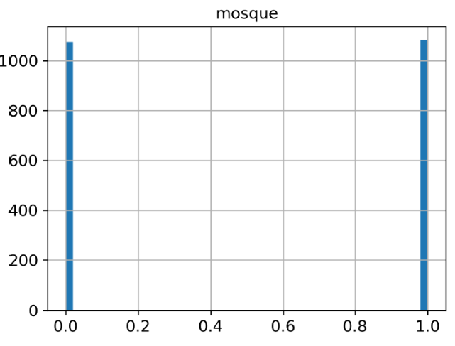
Balanced Attributes
X-axis: Attribute value
Y-axis: Number of records
1 indicates presence and 0 indicates the absence.

Slide 5
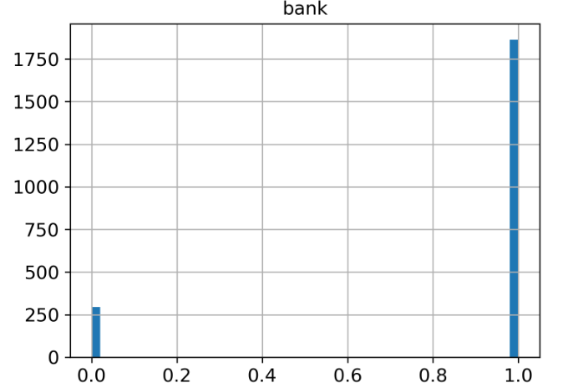
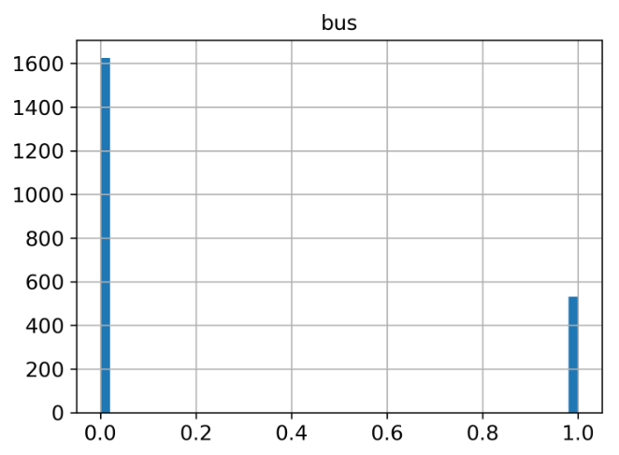
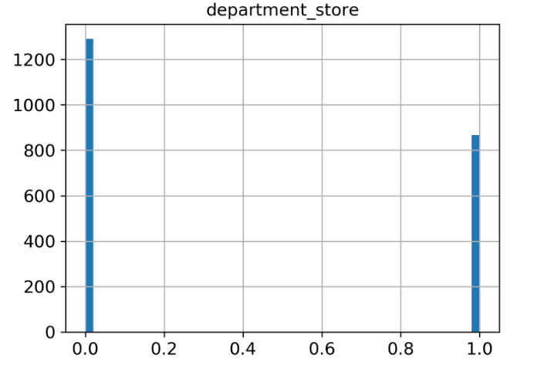
Unbalanced Attributes
These attributes contain unbalanced number of records with each class. Predictive models do not do well unbalanced class distribution.

Slide 6
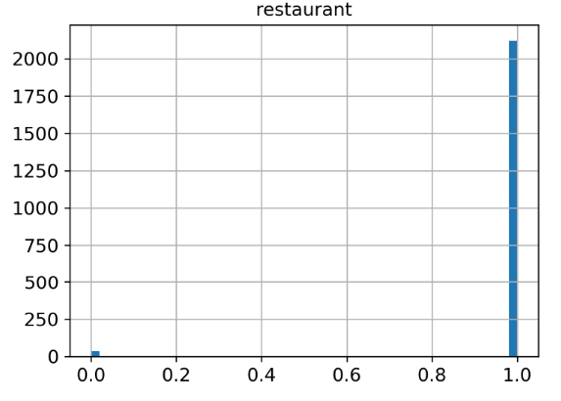
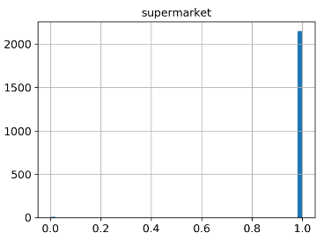
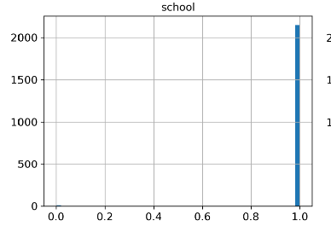
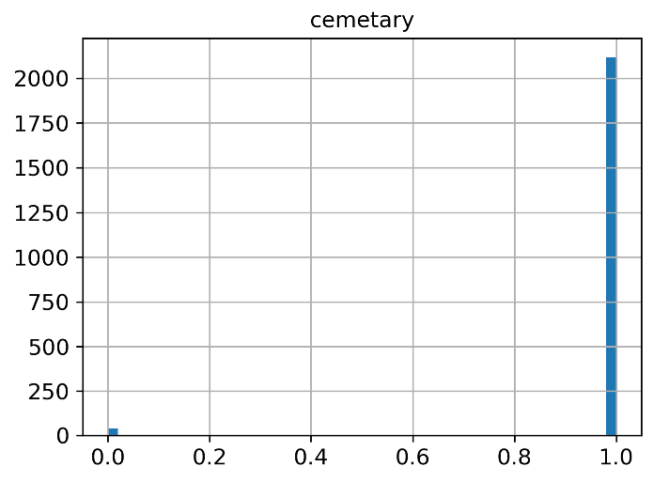
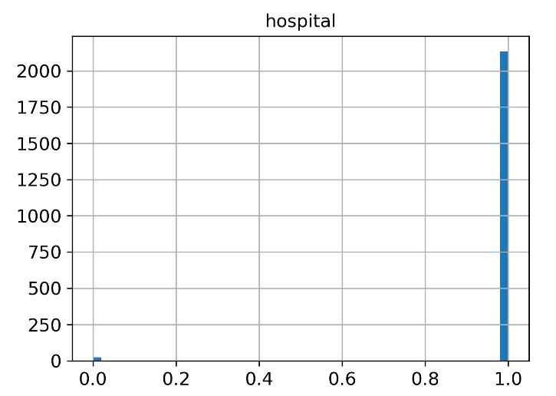
Useless Attributes
Dataset does not have records with absence of these places. So, these are of no use to predictive models.

Slide 7
Deductions from Attribute Value Histograms
Most of variables are not continuous. Firstly, binary variables are not suitable for predicting a continuous variable: price. Secondly, certain binary variables do not differentiate the magnitude of certain attributes (i-e: distance to bank). So, binary attributes must be replaced with suitable continuous attributes. For example, distance to bank, restaurant, school and other places can be added to the dataset.
Secondly, added distances attributes (or other similar attributes) can be converted into the categories (a certain range of the distances) for stratified sampling. Stratified sampling arranges all the dataset into categories. Then, we can choose equal number of samples from each category. This technique will minimize the sampling bias. Purely random sampling produces the skewed results.
Useless Attributes: Cemetery, hospital, restaurant, school and supermarket are present in almost all the records. So, these will not be helpful in predictive models. To balance the dataset, records with absence of these places should be added in the dataset. Moreover, replacing current values (1 or 0) with distances can help in better use of current dataset.
Remaining potential attributes: Area, bank, bus, mosque, department_store and park may prove helpful in predictive models. But, dataset needs more attributes for better results.

Slide 8
Correlation between Price & Other Attributes

Slide 9
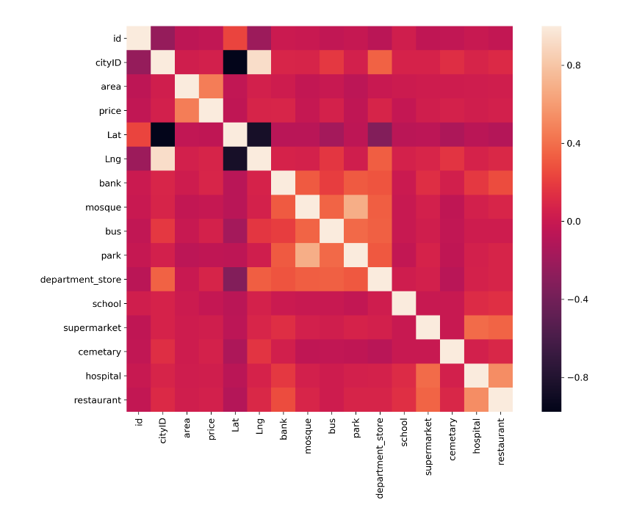
Correlation Matrix Plot

Slide 10
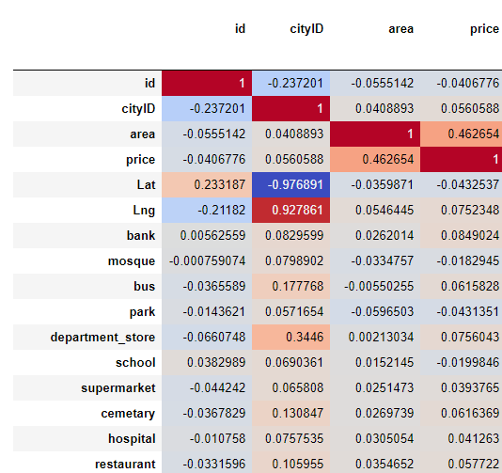
Correlation Matrix

Slide 11
Ordered Correlations with Price
price | 1.000000
area | 0.462654
category_F-7 | 0.282082
category_F-8 | 0.244955
category_E-7 | 0.196835
cemetery | 0.061637
category_Emporium Mall | 0.187667
category_F-10 | 0.174314
category_F-11 | 0.173792
category_Peco Road | 0.169332
category_Koral Chowk | 0.066197
bank | 0.084902
category_Ali Pur | 0.078118
category_F-6 | 0.077428
department_store | 0.075604
category_F-9 | 0.069864

Slide 12
Correlations with Price
bus | 0.061583
category_I-8 | 0.058287
restaurant | 0.057722
… | …
category_D-18 | -0.042296
category_I-16 | -0.042367
park | -0.043135
… | …
category_Ghauri Town | -0.056375
… | …

Slide 13
Deductions from Correlations
As expected, there is a strong correlation between the price and area.
Category variables do not have considerable correlation with the prices. Because, area and other attributes are not being considered in correlation calculation.
Correlation of price with previously separated potential attributes (area, bank, bus, mosque, park) is insignificant. This points to possibility of defects in the dataset collection, selection of dataset attributes and default attribute values/types. We can't certainly say that the correlation doesn't exist because there are other attributes affecting the price at the same time. For example, decrease in price is not significant due to absence of bank if the area of plot is high. Presence of defects can be confirmed by checking correlation between pair of attributes with the price. For example, correlation between (mosque, area) and price should be checked. One attribute in the pair should be area because it is most influential attribute in the dataset.

Slide 14
Visualizing Locations of Plots

Slide 15
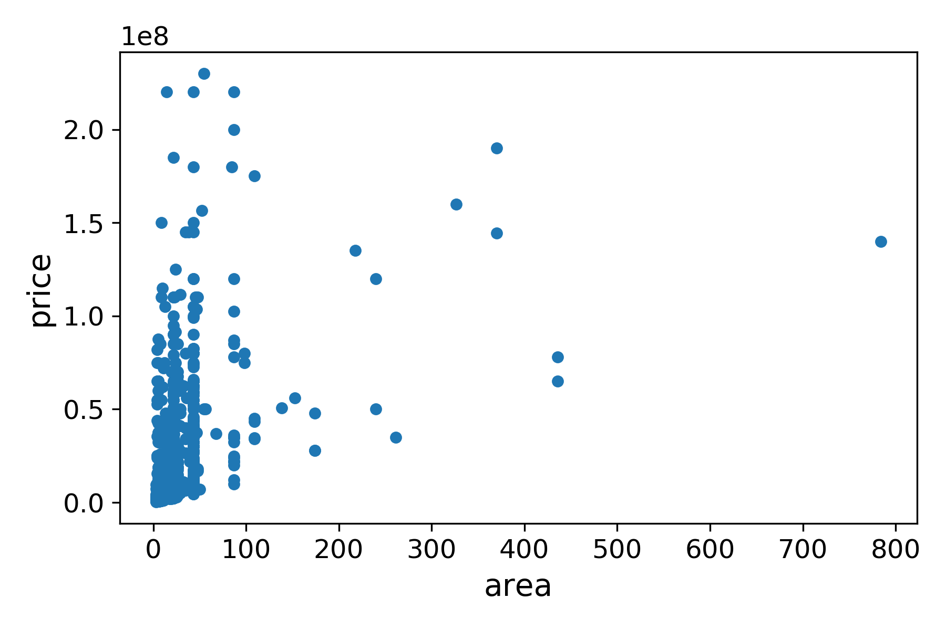
Price & Area
Predictive models won’t predict well for the areas greater than 200.

Slide 16
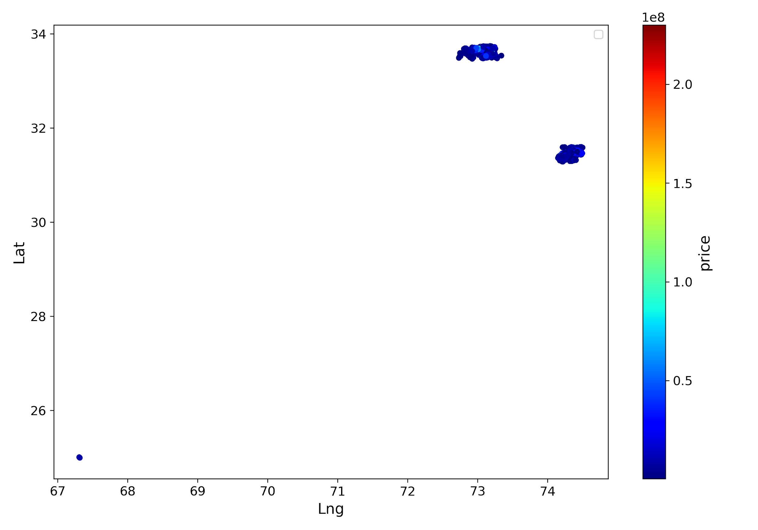
Locations of Plots
Islamabad
Lahore

Slide 17
Implications of Location Scatter Plots
Dataset points are very closely placed. So, most of the entries are from the same and nearly situated towns/colonies.
To better predict price differences in cities, attributes which count to difference of prices in cities should present in the dataset. There is not even a single such attribute in the dataset.
Possible new attributes to differentiate cities can be can be presence of people of certain social class (can be differentiated on the basis of their income, job, etc), presence of industries , number of malls, number of cinemas, number of parks, population etc.
Presence of places should be counted within a certain radius around the plots - preferably dataset should be collected with different radius values, best one can be found during training. Dataset collection with different radius does not need much resources, it will use the same algorithm multiple times.
Last but not the least, to predict the price differences within the towns/colonies, we need more attributes which count to price differences within towns/colonies . Currently, such attributes in the dataset are: area, bank, bus, mosque and park. Only area is a continuous variable here. Problems with the non-continuous variables are discussed earlier in "Attributes Histograms" section.

Slide 18
Results on Various ML Models

Slide 19
Comparison of ML Models
Model | RMSE on Test Set
Linear Regression | 1.440243 * 10¹⁷
Random Forest Regression | 1.427474 * 10⁷
Random Forest Regression (Hyper-parameters optimized by Grid-search) | 1.424681 * 10⁷
Decision Tree Regression | 1.317312 * 10⁷
Deep Learning Model 1 | 1.314346 * 10⁷
Deep Learning Model 2 | 1.188387 * 10⁷

Slide 20
Words about ML Models
Random Forests & Decision Trees performed comparable to Deep Learning models. This is because of the nature of of the dataset.
Deeper DL models can be used for better results along with hyper-parameter tuning. But, improvements won’t be significant without changing the dataset attributes.

Slide 21
Conclusion
Dataset should be validated through suggested correlation calculation approach. All the future work on this project depends on the dataset. Investing in the dataset can bring significant improvements in the results.
Most of suggested dataset improvements are not resource-extensive. Latitude & longitude of plots can be used to extract required attributes from the Google Maps. Cost-effective solution can be achieved through Node.js Frameworks & Google Maps APIs.
Dataset extension process can also be automated which can be used for other datasets.

